Slide 1
Group 7
Case study

Slide 2
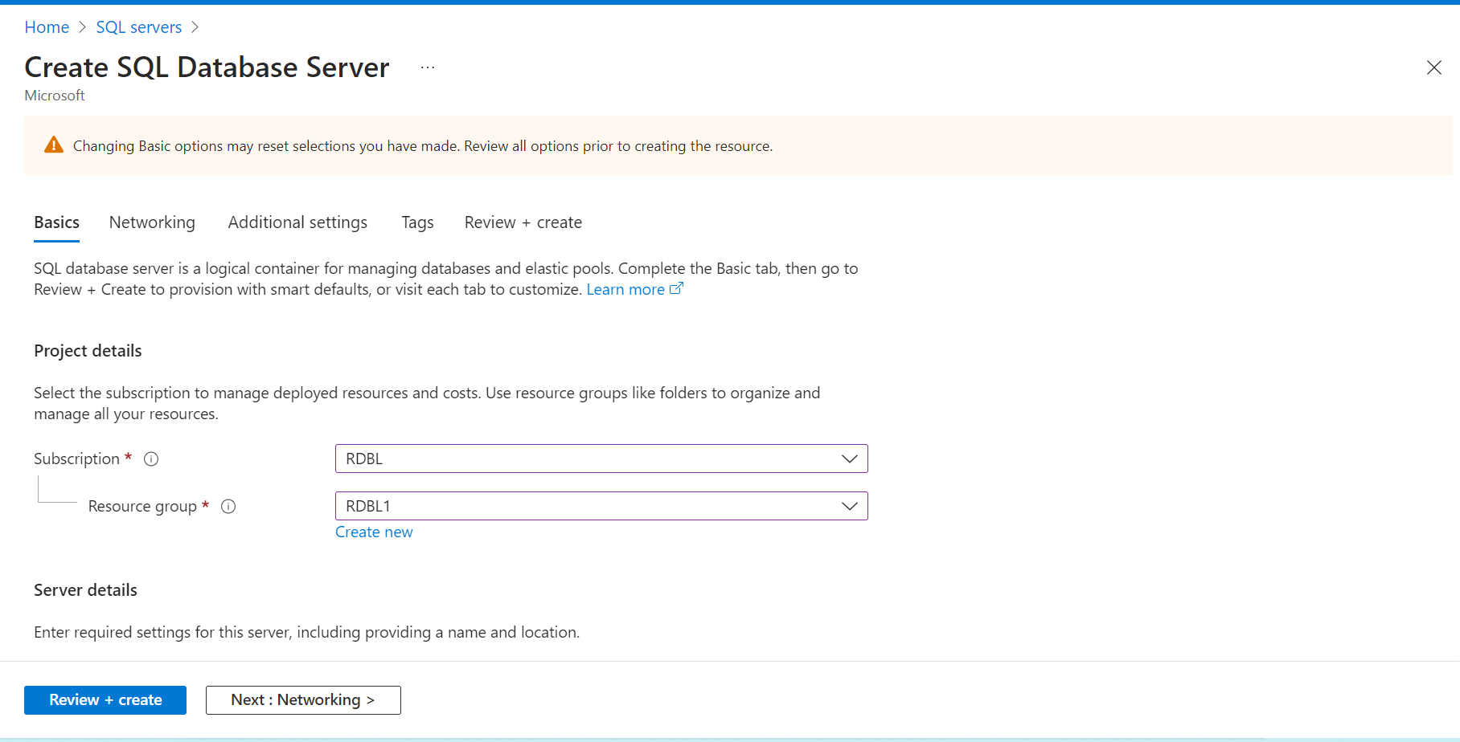

Slide 3
CREATE TABLE TotalSale (
id int NOT NULL
,SalePersonFName varchar(100) NULL
,SalePersonLName varchar(100) NULL
,ProductName varchar(100) NULL
,ItemsSold int NULL
,SoldPrice int NULL
,Country varchar(100) NULL
,Region varchar(100) NULL
)
INSERT into TotalSale (
id
,SalePersonFName
,SalePersonLName
,ProductName
,ItemsSold
,SoldPrice
,Country
,Region
)
VALUES (1,'Aamir','Shahzad','TV',1 ,700,'USA','North
America');

Slide 4
INSERT into TotalSale (
id
,SalePersonFName
,SalePersonLName
,ProductName
,ItemsSold
,SoldPrice
,Country
,Region
)
VALUES(2,'M','Raza','Cell Phone',2,800,'USA','North America');
INSERT into TotalSale (
id
,SalePersonFName
,SalePersonLName
,ProductName
,ItemsSold
,SoldPrice
,Country
,Region
)
VALUES(3,'Christy','Ladson','TV',3,1600,'USA','North
America');

Slide 5
INSERT into TotalSale (
id
,SalePersonFName
,SalePersonLName
,ProductName
,ItemsSold
,SoldPrice
,Country
,Region
)
VALUES(4,'John','Rivers','Laptop',5,2400,'USA','North
America');
INSERT into TotalSale (
id
,SalePersonFName
,SalePersonLName
,ProductName
,ItemsSold
,SoldPrice
,Country
,Region
)
VALUES(5,'Najaf','Ali','Computer',1,300,'Pakistan','Asia');

Slide 6
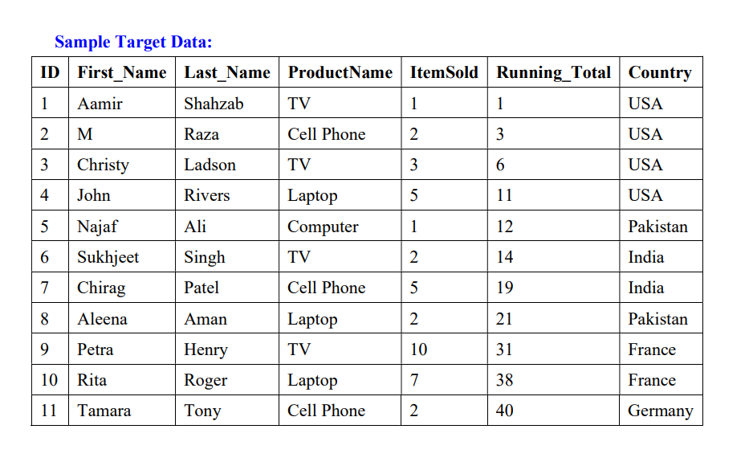
Sample database

Slide 7
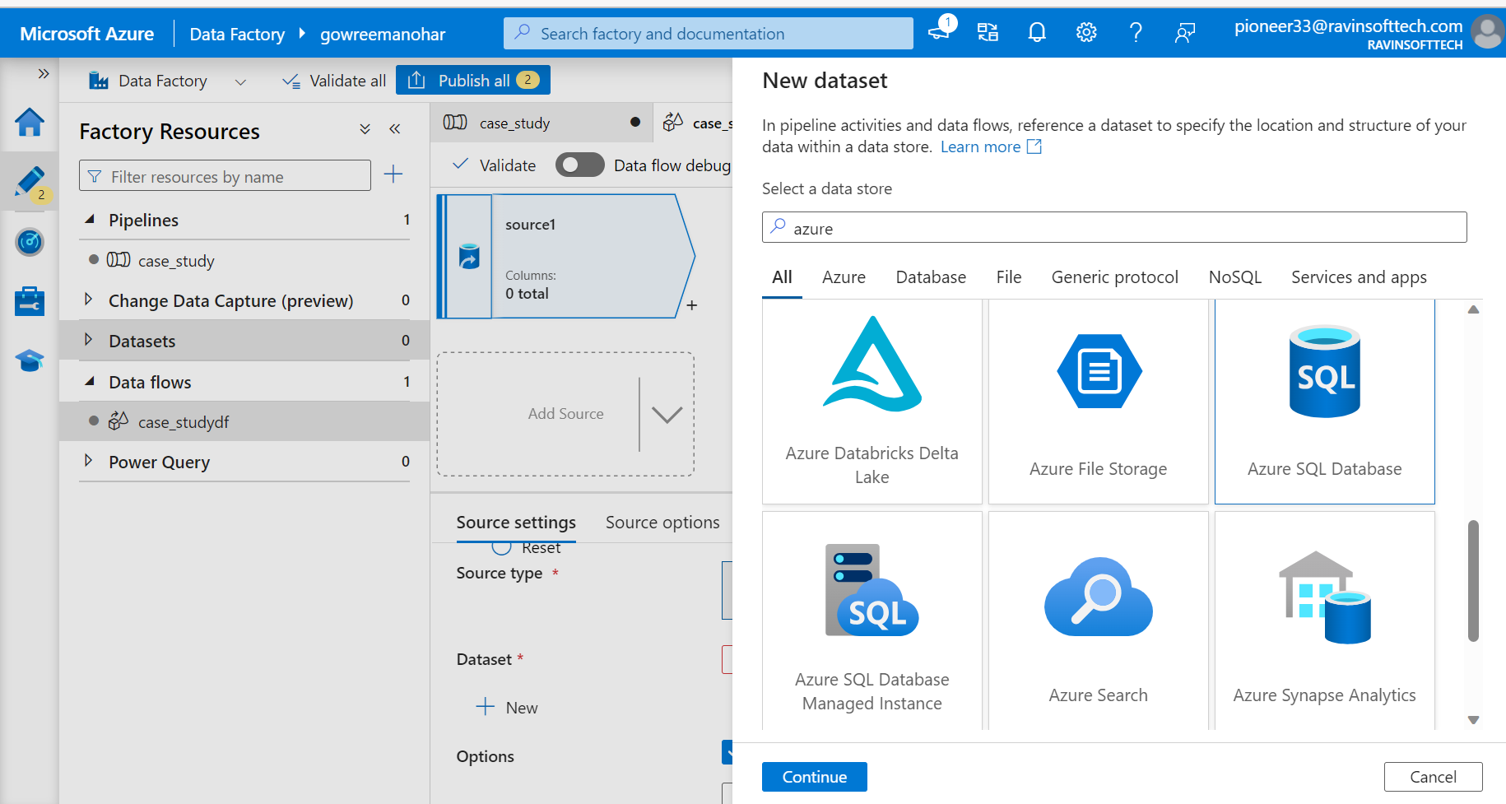
Creating dataset

Slide 8
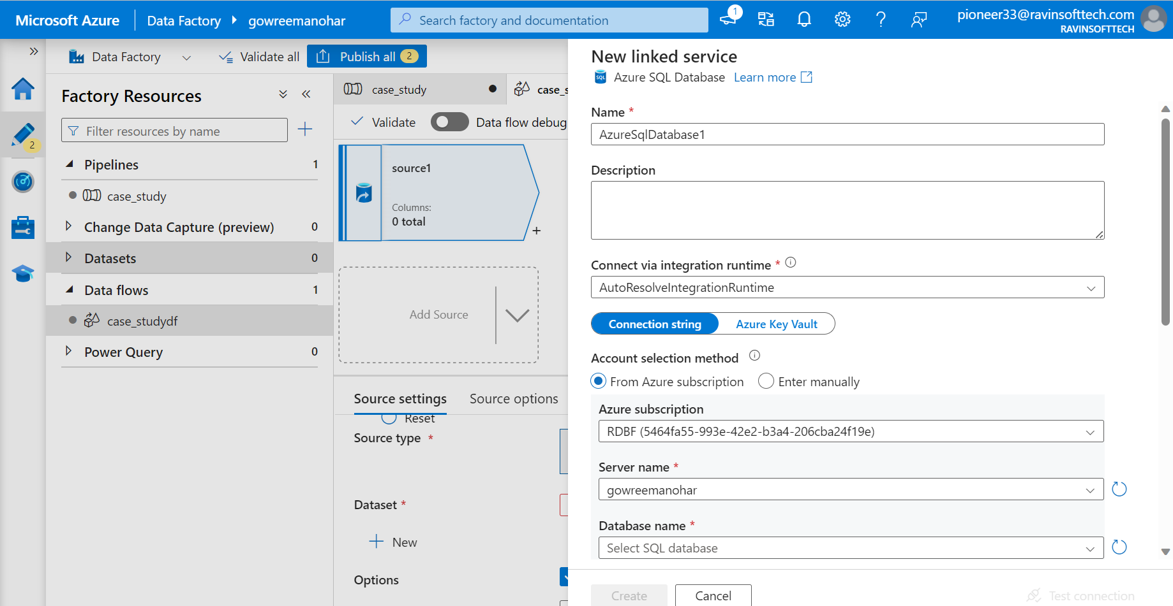
Creating linked service

Slide 9
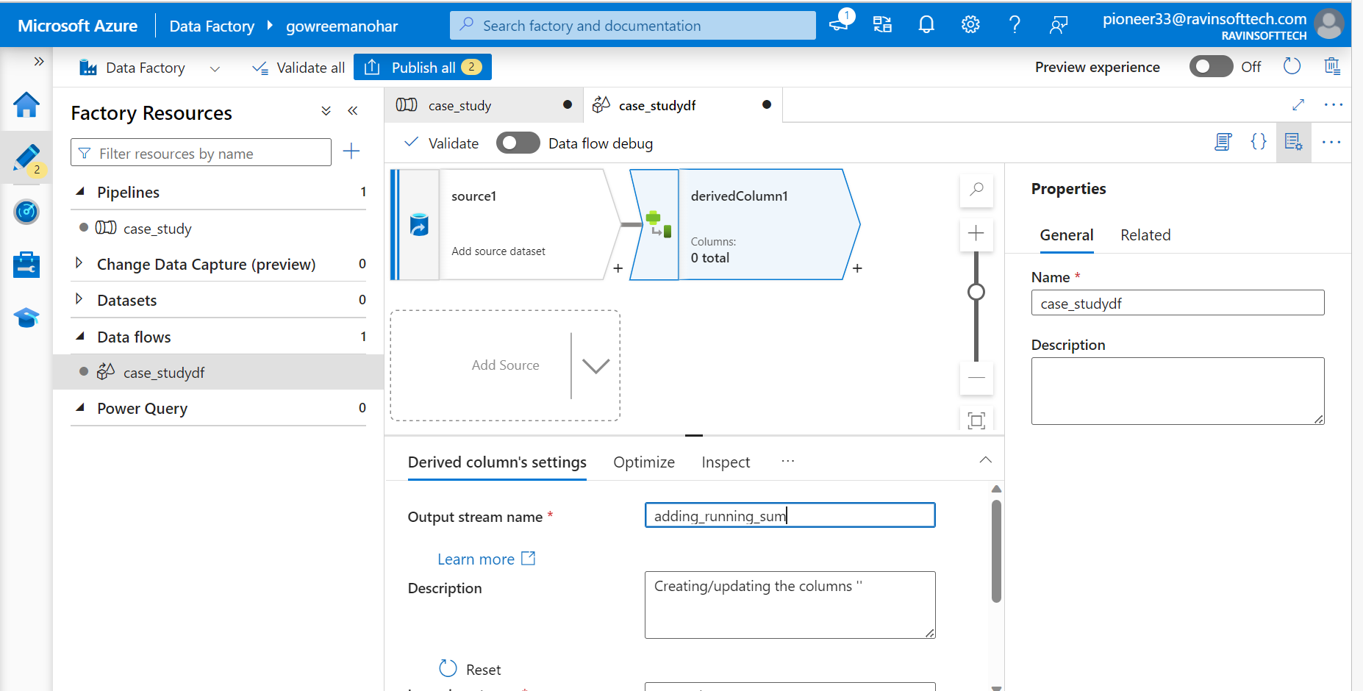
Creating dataflow

Slide 10
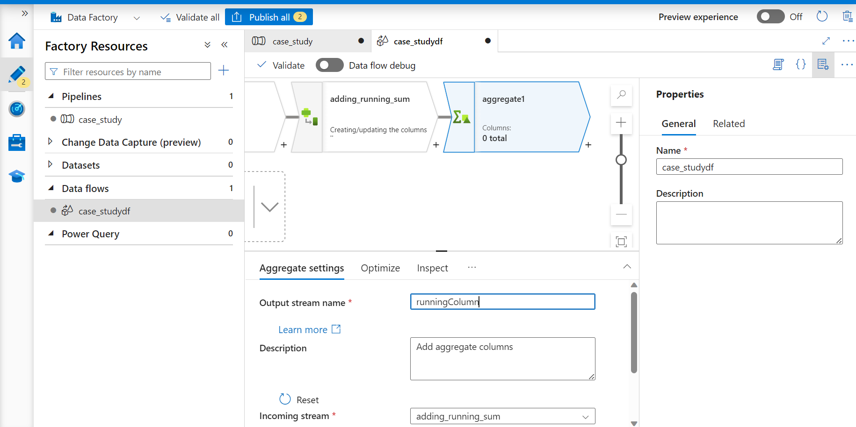
Creating aggregate function

Slide 11
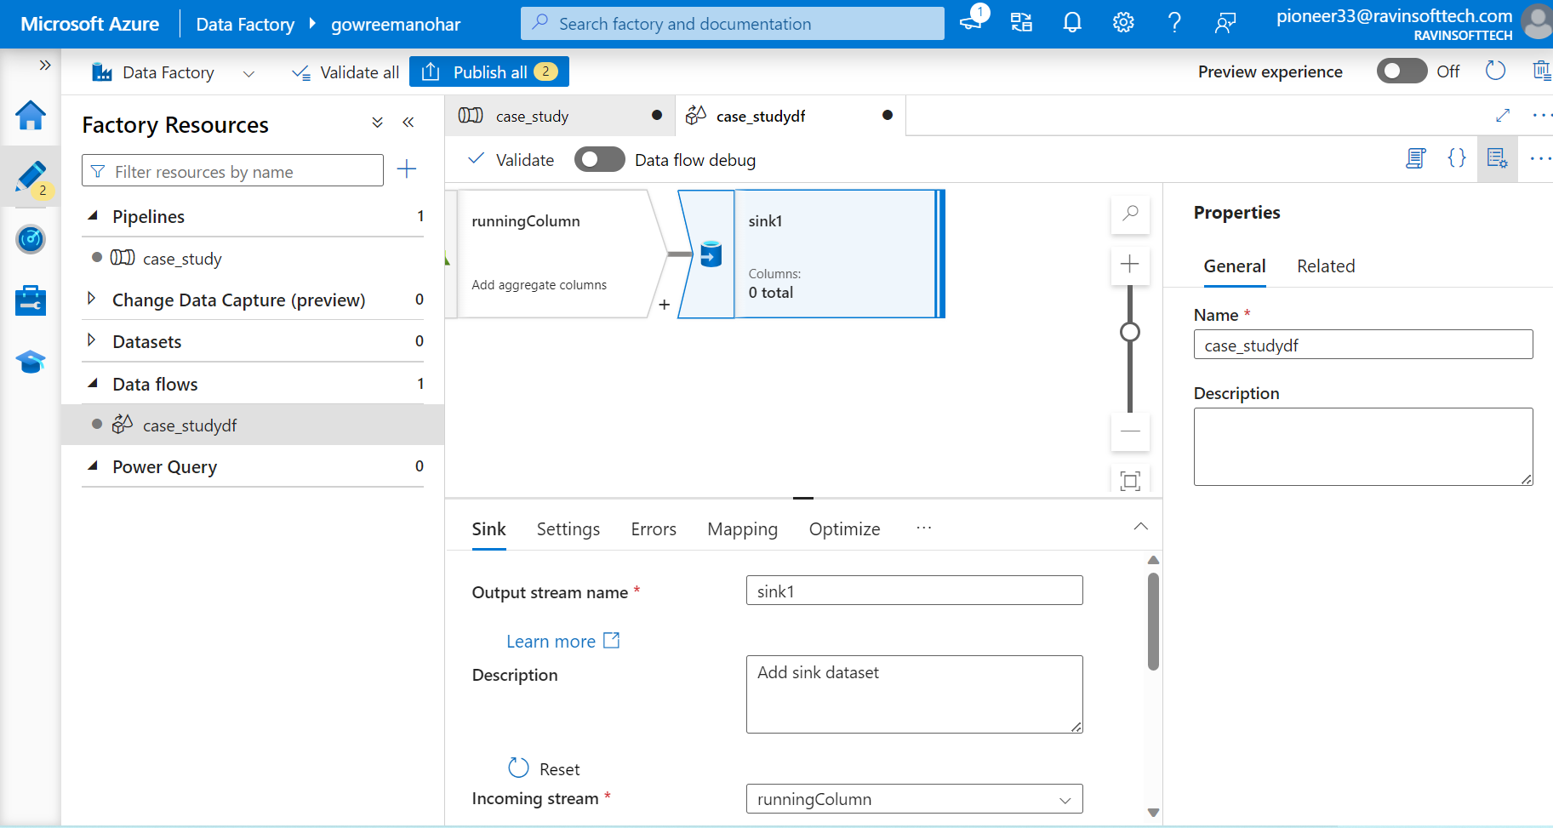
Creating sink

Slide 12
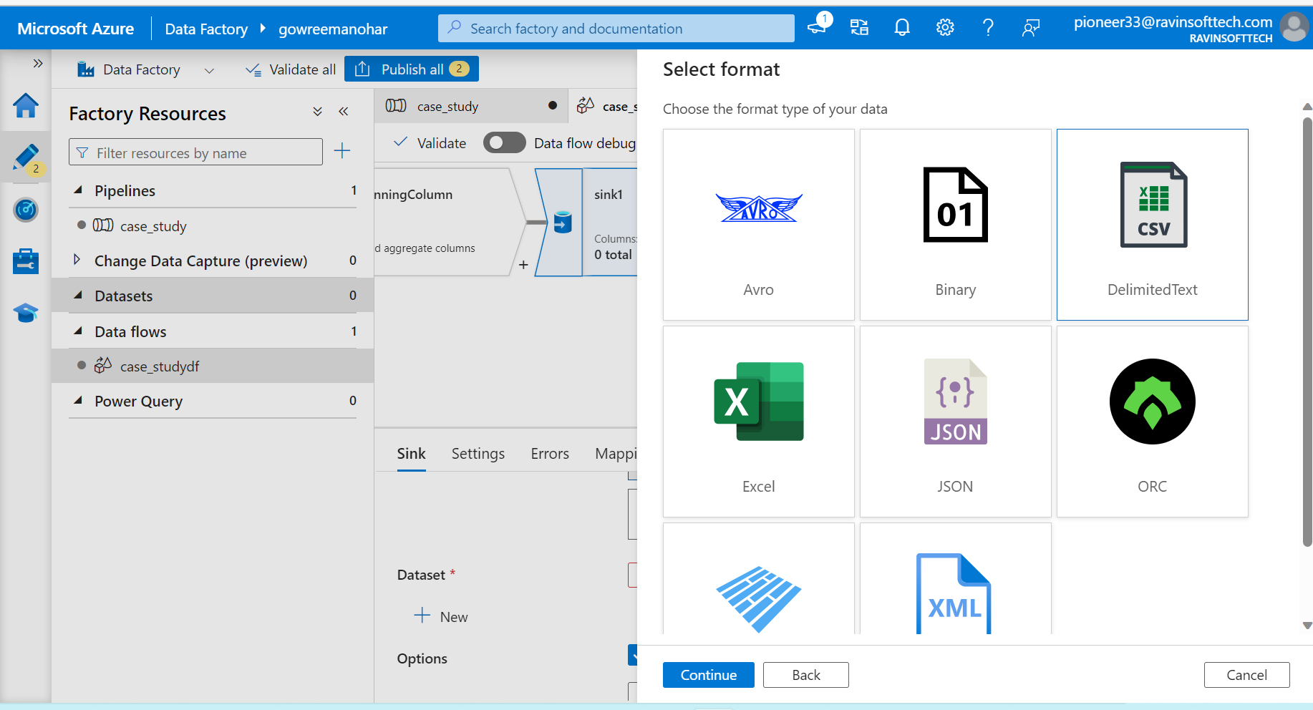
Output csv

Slide 13
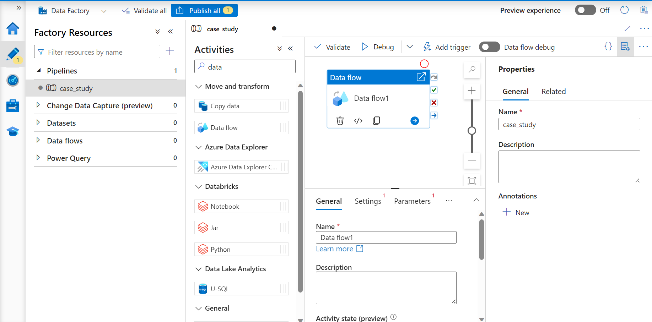
Creating data pipeline

Slide 14
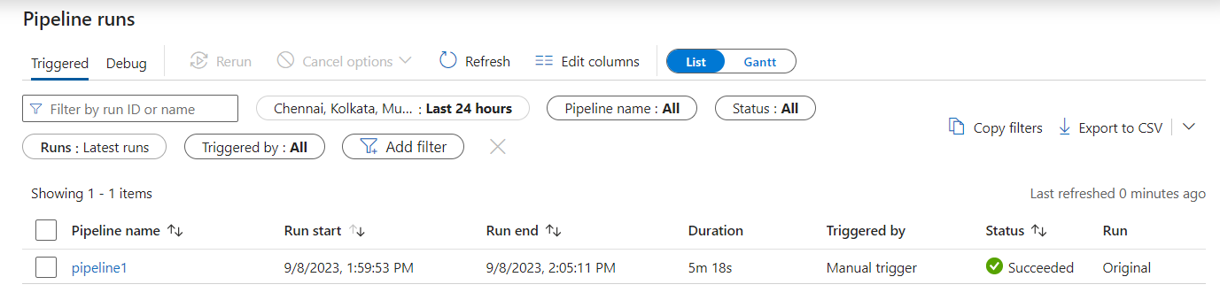
Pipeline run

Slide 15
